Slide 1
Gonzaga Men’s Basketball Yahtzee Game
31 April 2018

Slide 2
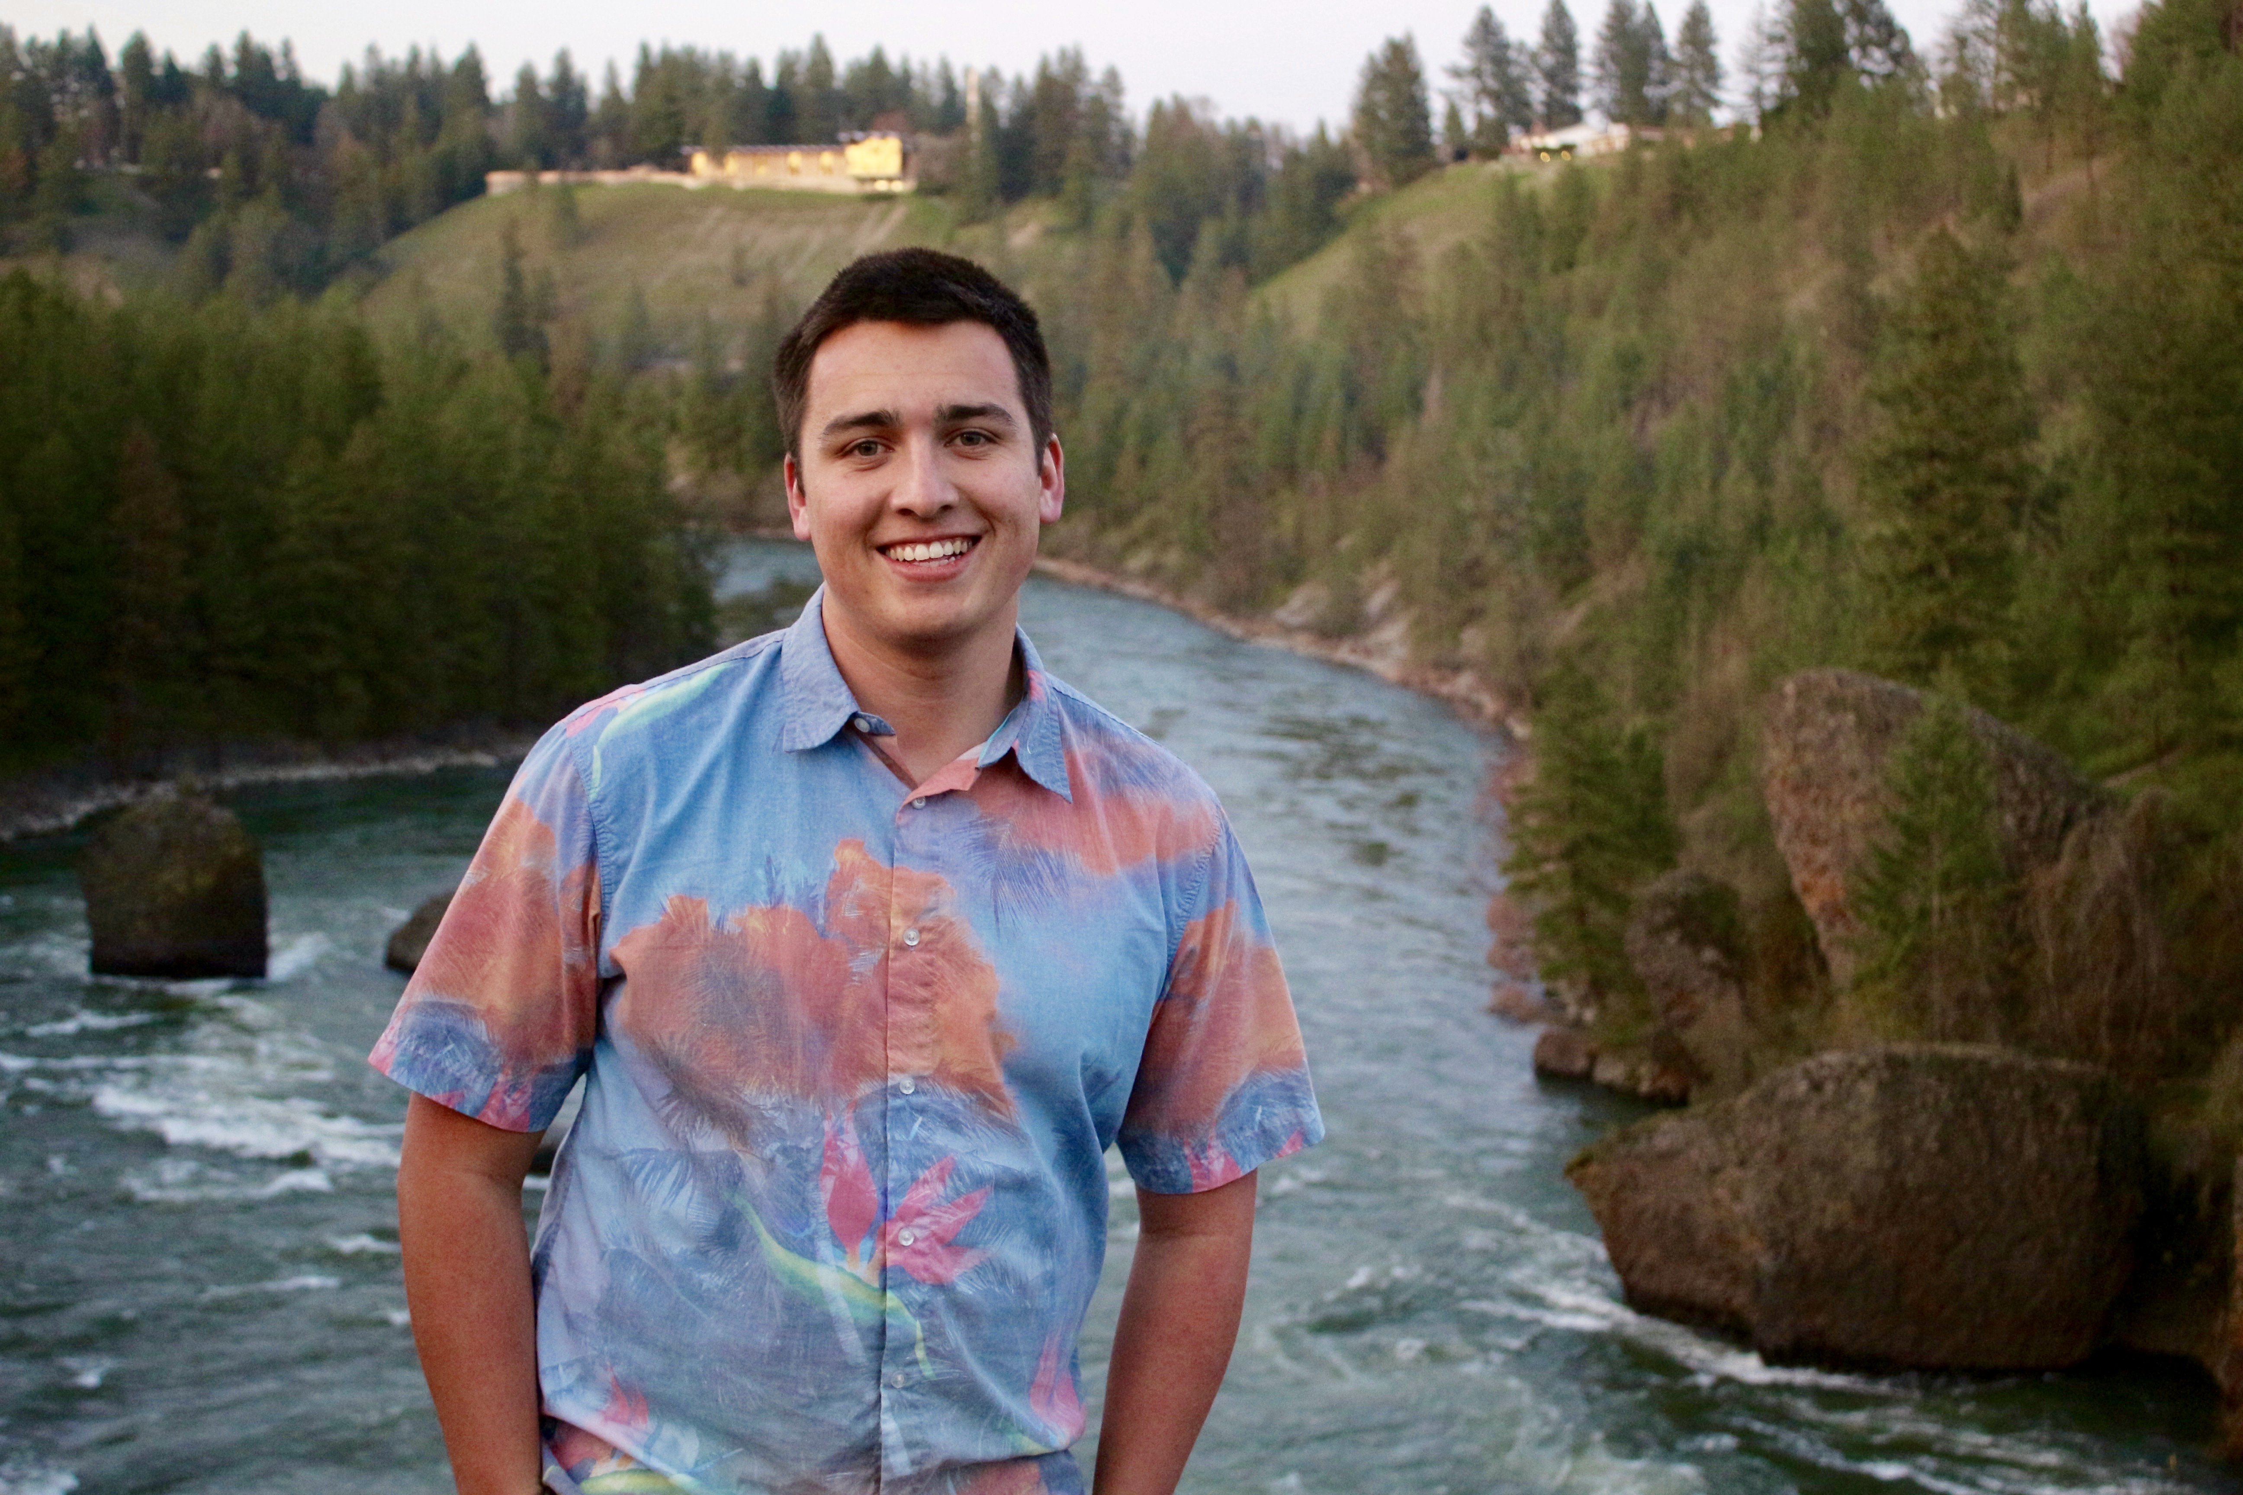
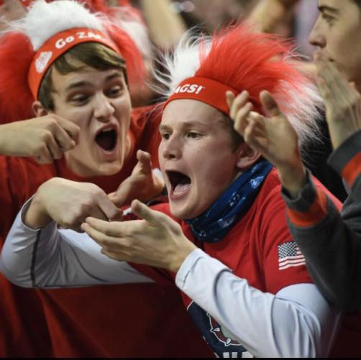
Introduction
Benjamin Bladow
Eugene Krug
Brandon Niblock

Slide 3
Problem Statement
Taking a traditional Yahtzee game, making modifications, and implementing it using a Graphical User Interface (GUI) in Java
One of the most significant modifications in our game: a theme
Gonzaga Men's Basketball
i.e. fifteen-sided die with each side of the die representing a player on the 2017-2018 team roster
A multi-user game that tracks users' scores and maintains a leaderboard
For the purposes of clarity, “user” refers to the people playing the game and “player” refers to a Gonzaga Men's Basketball Player.

Slide 4
Features
Leaderboard
Maintains and displays the top 3 highest scores in game history
Click through instructions
Picture buttons
Basketball image to roll
Player’s photos to keep in hand
Panels indicate who’s turn it is and what roll number it is
Sequenced buttons
i.e. “Next” button does not appear until “Submit” button is clicked

Slide 5
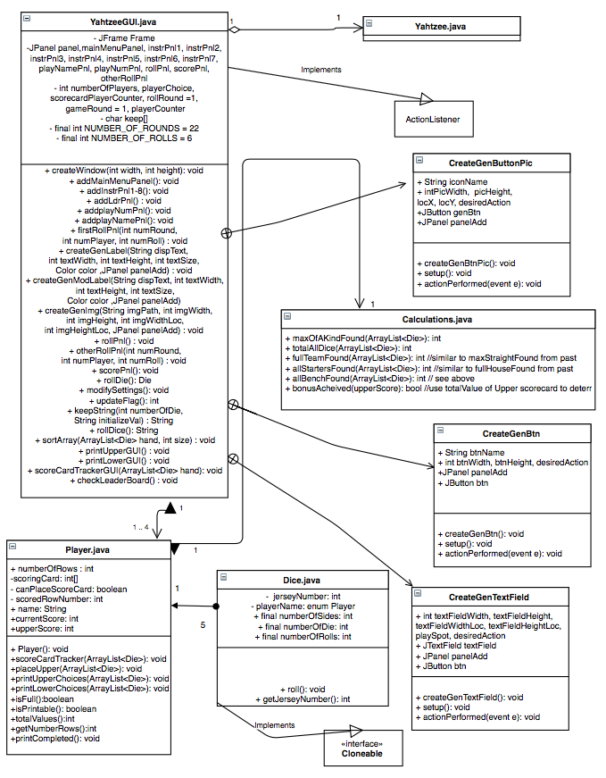
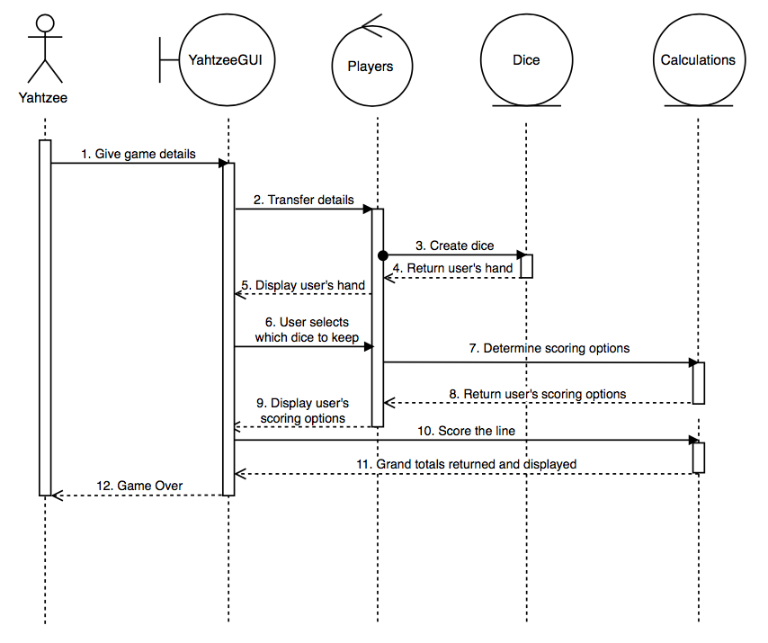
Structure and Design

Slide 6
Structure and Design
5 classes
Yahtzee
YahtzeeGUI
Calculations
Dice
Player
4 “Key” Panels
Main Menu
Play
Leaderboard
Instructions
Required files
All code
Graphics
Leaderboard.txt

Slide 7
Future Extension
Improved GUI Appearance: For example, it would look nicer if the panel background was a thematic image, as opposed to a plain color.
Enhanced User-Input Validation: For example, it would have been more user-friendly if an error message appeared if the user entered bad input (i.e. a user name that is NOT one word). Our game does not take bad input. The user is allowed to retry and enter valid input. For instance, on the scoring card if the user enters an invalid line to score and clicks submit, the next button does not appear. Once the user does enter valid input, the next button does appear and the user can continue with the game as expected.

Slide 8
Conclusion
Issues unaddressed
Fortunately, but not by chance, no issues exist or remain with the game based on our functional requirements. There are improvements that could be made as previously discussed, however, they are not current issues.
Working as a team
First long-term project each of us has done
First time any of us have worked with a group (we have worked individually or with a partner previously)
We enjoyed this project and liked the long-term approach that justified a serious investment in the project
We enjoyed working together and became closer in the process.
Frustrations at times (i.e. finding times to meet)
No disagreements over how to design or implement the game
All of us were very understanding of each other’s opinions and we agreed on a compromise when applicable
Good balance of meeting and working together and dividing work and completing it on our own
“Experts” in certain areas of the project and we utilized this to our benefit
Regularly met: reviewing each other’s work and a final review at the end of the project

Slide 9
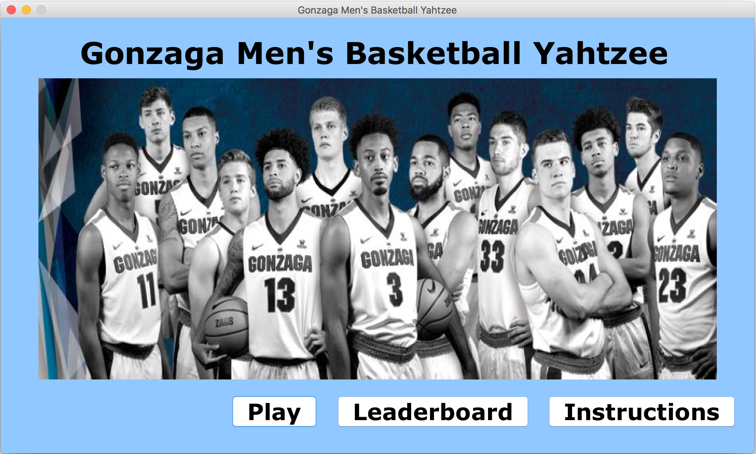
Demonstration

Slide 10
Conclusion
Questions and Answers

